Slide 1
Software Quality Assurance
CT6005
Week-5
Quality Metrics

Slide 2
“You can’t control what you can’t measure” Tom DeMarco
Measurement
is the act of obtaining a measure
Measure
provides a quantitative indication of the size of some product or process attribute, E.g., Number of errors
Metric
is a quantitative measure of the degree to which a system, component, or process possesses a given attribute (IEEE Software Engineering Standards 1993) : Software Quality - E.g., Number of errors found per person hours expended

Slide 3
IEEE definitions
(1) A quantitative measure of the degree to which an item possesses a given quality attribute.
(2) A function whose inputs are software data and whose output is a single numerical value that can be interpreted as the degree to which the software possesses a given quality attribute.

Slide 4
Objectives
1. Facilitate management control, planning and managerial intervention. Based on:
· Deviations of actual from planned performance.
· Deviations of actual timetable and budget performance from planned.
2. Identify situations for development or maintenance process improvement (preventive or corrective actions). Based on:
· Accumulation of metrics information regarding the performance of teams, units, etc.

Slide 5
Benefits of Software Metrics
Increase return on investment (ROI) Software development
Identify areas of improvement
Manage workloads
Reduce overtime
Reduce costs

Slide 6
Benefits of Software Metrics
Metrics are an important component of quality assurance, management, debugging, performance, and estimating costs
they’re valuable for both developers and development team leaders.

Slide 7
Benefits for Managers
can use software metrics to identify, prioritize, track and communicate any issues to foster better team productivity.
enables effective management and allows assessment and prioritization of problems within software development projects.
can detect software problems, the easier and less-expensive the troubleshooting process.

Slide 8
Benefits for Software development teams
to communicate the status of software development projects
pinpoint and address issues
monitor, improve on
better manage their workflow

Slide 9
What to measure
Process
Measure the efficacy of processes. What works, what doesn’t.
effectiveness of defect removal, pattern of testing defect arrival, and response time of fixes
Project
Assess the status of projects. Track risk. Identify problem areas. Adjust work flow.
number of developers, cost, schedule, productivity, etc. fairly straight forward
Product
Measure predefined product attributes (generally related to ISO9126 Software Characteristics)
size, complexity, design features, performance, and quality level

Slide 10
Types of measures
Direct measures
of software engineering process include cost and effort.
of the product include lines of code (LOC), execution speed, memory size, defects per reporting time period.
Indirect measures
examine the quality of the software product itself (e.g. functionality, complexity, efficiency, reliability, maintainability).

Slide 11
SW Size/Volume Measures
KLOC — classic metric that measures the size of software by thousands of code lines.
Number of function points (NFP) — a measure of the development resources (human resources) required to develop a program, based on the functionality specified for the software system

Slide 12
Process Metrics
S/W development process metrics fall into one of the following categories:
1-Software process quality metrics
Error density metrics
Error severity metrics
Error removal effectiveness metrics
2- Software process timetable metrics
3- Software process productivity metrics

Slide 13
Activity
Lines of code (LOC) is a common measure of software development.
If an organization uses productivity metrics that emphasize volume of code and errors, what kind of issue/problem(s) does a SW development team have? Please specify them and explain why.

Slide 14
Error Density Metrics
Calculation of error density metrics involves two measures:
1- Software volume measures. Some density metrics use the number of lines of code while others apply function points.
2- Errors counted measures. Some relate to the number of errors(NCE) and others to the weighted number of errors (WCE).
this measure is classification of the detected errors into severity classes, followed by weighting each class.

Slide 15
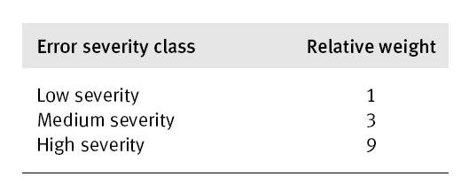
Example
A software development department applies two alternative measures, NCE and WCE, to the code errors detected in its software development projects. Three classes of error severity and their relative weights are also defined:
there were 42 low severity errors, 17 medium severity errors, and 11 high severity errors

Slide 16
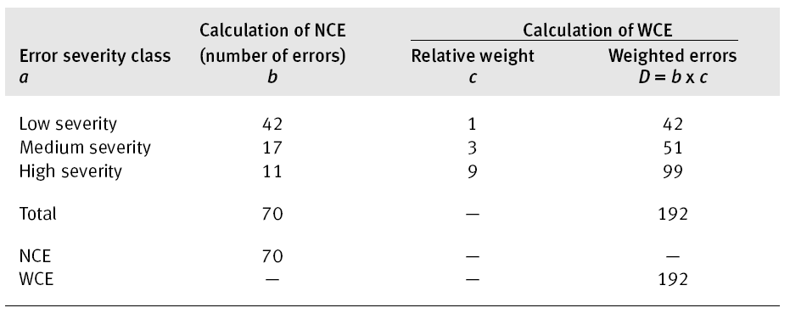

Slide 17
Error Severity Metrics
The metrics belonging to this group are used to detect adverse situations of increasing numbers of severe errors in situations where errors and weighted errors, as measured by error density metrics, are generally decreasing.
Two error severity metrics are presented as follows:
ASCE: Average Severity of Code Errors
ASDE: Average Severity of Development Errors

Slide 18
An example
2 different project teams are working to record errors in a software process
Team A – Finds 342 errors during software process before release
Team B- Finds 184 errors
Which team do you think is more effective in finding errors?
Notes:
It really depends on the types of errors found (severity) and not only the number of errors (Density)
One error of high severity might be more important than hundreds of other types of errors

Slide 19
More quality metrics
Software quality factors requiring measures:
correctness (defects per KLOC)
maintainability
mean time to change (MTTC)
spoilage = (cost of change / total cost of system)
integrity
threat = probability of attack (that causes failure)
security = probability attack is repelled
Integrity = Σ [1 - threat * (1 - security)]

Slide 20
More quality metrics
usability
easy to learn (time)
easy to use (time)
productivity increase (quantity)
user attitude (questionnaire score)
defect removal efficiency
DRE = E / (E + D).
E = # of errors found before delivery
D = # of errors found after delivery
Notes:
The closer to 1 DRE is, the fewer defects found after product delivery.

Slide 21
Types of Agile Metrics
Lean metrics – Focus on ensuring a flow of value from the organization to its customers and eliminating wasteful activities. Common metrics include lead time and cycle time.
Kanban metrics – Focus on workflow, organizing and prioritizing work and getting it done. A common metric is a cumulative flow.
Scrum metrics – Focus on the predictable delivery of working software to customers. Common metrics include the burndown chart and team velocity.

Slide 22
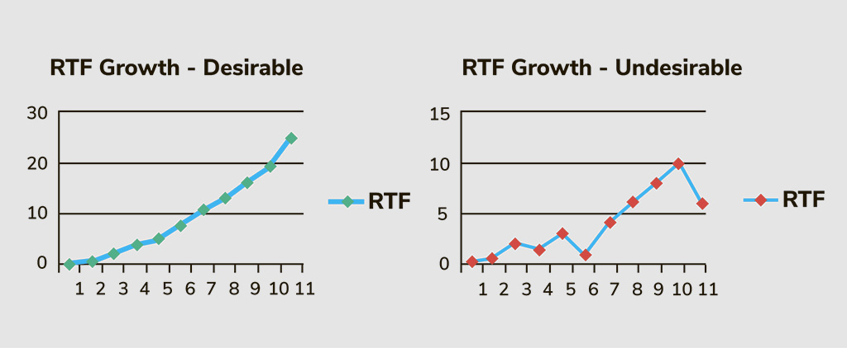
Running Tested Features (RTF)
how many software features are fully developed and passing all acceptance tests, thus becoming implemented in the integrated product.
The RTF metric for the project on the left shows more fully developed features as the sprint progresses, making for a healthy RTF growth. The project on the right appears to have issues, which may arise from factors including defects, failed tests, and changing requirements.

Slide 23
Cumulative Flow Diagram (CFD)
shows summary information for a project, including work-in-progress, completed tasks, testing, velocity, and the current backlog.
The following diagram allows you to visualize bottlenecks in the Agile process: Colored bands that are disproportionately fat represent stages of the workflow for which there is too much work in progress. Bands that are thin represent stages in the process that are “starved” because previous stages are taking too long.

Slide 24
Earned Value Management
encompasses a series of measurements to compare a planned baseline value before the project begins with actual technical progress and hours spent on the project.
The comparison is typically in the form of a dollar value, and it requires particular preparation to use in an Agile framework, incorporating story points to measure earned value and planned value. You can use EVM methods at many levels, from the single task level to the total project level.

Slide 25
Percentage of Automated Test Coverage
measures the percentage of test coverage achieved by automated testing. As time progresses and more tests get automated

Slide 26
Code Complexity & Static Code Analysis
Often derived via a measure named cyclomatic complexity, the code complexity metric counts number of linearly independent paths through a program’s source code.
Static code analysis uses a set of tools to examine the code without executing it. For example, a compiler can analyze code to find lexical errors, syntax mistakes, and sometimes semantic errors. Therefore, static analysis is a good way to check for sound coding standards in a program.

Slide 27
Defect Cycle Time
Defect cycle time measures how much time elapses between starting work on fixing a bug and fully resolving that bug.

Slide 28
Defect Spillover

Slide 29
Resources
https://www.sealights.io/test-metrics/testing-metrics-in-agile-development/

